Slide 1
Network Address Translation
Network Address Translation (NAT) is a technique used in networking to map private IP addresses within a local network to a single public IP address or a set of public IP addresses.
NAT helps in managing IP address usage, enhancing security, and allowing multiple devices to share a single public IP address.
The basic idea behind NAT is to assign each company a single IP address (or at most, a small number of them) for Internet traffic. Within the company, every computer gets a unique IP address, which is used for routing intramural traffic. However, when a packet exits the company and goes to the ISP, an address translation takes place.
To make this scheme possible, three ranges of IP addresses have been declared as private. Companies may use them internally as they wish.
10.0.0.0 – 10.255.255.255/8 (16,777,216 hosts)
172.16.0.0 – 172.31.255.255/12 (1,048,576 hosts)
192.168.0.0 – 192.168.255.255/16 (65,536 hosts)

Slide 2
Network Address Translation
The operation of NAT is shown in Figure. Within the company premises, every machine has a unique address of the form 10.x.y.z. However, when a packet leaves the company premises, it passes through a NAT box that converts the internal IP source address, 10.0.0.1 in the figure, to the company's true IP address, 198.60.42.12 in this example.
The NAT box is often combined in a single device with a firewall, which provides security by carefully controlling what goes into the company and what comes out.
When the reply comes back (e.g., from a Web server), it is naturally addressed to 198.60.42.12, so how does the NAT box know which address to replace it with? Herein lies the problem with NAT.
If there were a spare field in the IP header, that field could be used to keep track of who the real sender was, but only 1 bit is still unused.
In principle, a new option could be created to hold the true source address, but doing so would require changing the IP code on all the machines on the entire Internet to handle the new option. This is not a promising alternative for a quick fix.

Slide 3
Network Address Translation
How NAT Works :
Translation Process:
Outbound Traffic: When a device on the internal network (private IP) sends traffic to the internet, NAT translates the private IP address and port number to a public IP address and a unique port number. The translation is recorded in a NAT table.
Inbound Traffic: When a response comes back from the internet, NAT uses the NAT table to map the public IP address and port number back to the original private IP address and port number, and forwards the traffic to the correct internal device.
NAT Table:
Content: Stores mappings between private IP addresses/ports and public IP addresses/ports. This table is used to keep track of active connections and their translations.
Purpose: Ensures that responses from the internet are correctly routed back to the originating internal device.

Slide 4
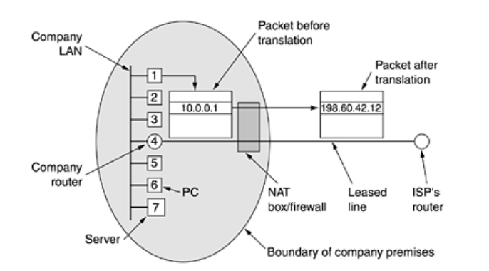
Network Address Translation

Slide 5
Network Address Translation
The NAT designers observed that most IP packets carry either TCP or UDP payloads.
When a process wants to establish a TCP connection with a remote process, it attaches itself to an unused TCP port on its own machine. This is called the source port and tells the TCP code where to send incoming packets belonging to this connection.
The process also supplies a destination port to tell who to give the packets to on the remote side. Ports 0–1023 are reserved for well-known services.
For example, port 80 is the port used by Web servers, so remote clients can locate them. Each outgoing TCP message contains both a source port and a destination port. Together, these ports serve to identify the processes using the connection on both ends.
Whenever an outgoing packet enters the NAT box, the 10.x.y.z source address is replaced by the company's true IP address. In addition, the TCP Source port field is replaced by an index into the NAT box's 65,536-entry translation table. This table entry contains the original IP address and the original source port.
Finally, both the IP and TCP header checksums are recomputed and inserted into the packet. It is necessary to replace the Source port because connections from machines 10.0.0.1 and 10.0.0.2 may both happen to use port 5000, for example, so the Source port alone is notenough to identify the sending process.

Slide 6
Network Address Translation
When a packet arrives at the NAT box from the ISP, the Source port in the TCP header is extracted and used as an index into the NAT box's mapping table.
From the entry located, the internal IP address and original TCP Source port are extracted and inserted into the packet.
Then both the IP and TCP checksums are recomputed and inserted into the packet. The packet is then passed to the company router for normal delivery using the 10.x.y.z address.
NAT can also be used to alleviate the IP shortage for ADSL and cable users. When the ISP assigns each user an address, it uses 10.x.y.z addresses.
When packets from user machines exit the ISP and enter the main Internet, they pass through a NAT box that translates them to the ISP's true Internet address.
On the way back, packets undergo the reverse mapping. In this respect, to the rest of the Internet, the ISP and its home ADSL/cable users just looks like a big company.

Slide 7
Network Address Translation
First, NAT violates the architectural model of IP, which states that every IP address uniquely identifies a single machine worldwide.
The whole software structure of the Internet is built on this fact. With NAT, thousands of machines may (and do) use address 10.0.0.1.
Second, NAT changes the Internet from a connectionless network to a kind of connection oriented network.
The problem is that the NAT box must maintain information (the mapping) for each connection passing through it. Having the network maintain connection state is a property of connection-oriented networks, not connectionless ones.
If the NAT box crashes and its mapping table is lost, all its TCP connections are destroyed. In the absence of NAT, router crashes have no effect on TCP.
The sending process just times out within a few seconds and retransmits all unacknowledged packets. With NAT, the Internet becomes as vulnerable as a circuit-switched network.

Slide 8
Network Address Translation
Third, NAT violates the most fundamental rule of protocol layering: layer k may not make any assumptions about what layer k + 1 has put into the payload field.
This basic principle is there to keep the layers independent. If TCP is later upgraded to TCP-2, with a different header layout (e.g., 32-bit ports), NAT will fail.
The whole idea of layered protocols is to ensure that changes in one layer do not require changes in other layers. NAT destroys this independence.
Fourth, processes on the Internet are not required to use TCP or UDP.
If a user on machine A decides to use some new transport protocol to talk to a user on machine B (for example, for a multimedia application), introduction of a NAT box will cause the application to fail because the NAT box will not be able to locate the TCP Source port correctly.

Slide 9
Network Address Translation
Fifth, some applications insert IP addresses in the body of the text. The receiver then extracts these addresses and uses them.
Since NAT knows nothing about these addresses, it cannot replace them, so any attempt to use them on the remote side will fail. FTP, the standard File Transfer Protocol works this way and can fail in the presence of NAT unless special precautions are taken.
Similarly, the H.323 Internet telephony has this property and can fail in the presence of NAT. It may be possible to patch NAT to work with H.323, but having to patch the code in the NAT box every time a new application comes along is not a good idea.
Sixth, since the TCP Source port field is 16 bits, at most 65,536 machines can be mapped onto an IP address. Actually, the number is slightly less because the first 4096 ports are reserved for special uses.
However, if multiple IP addresses are available, each one can handle up to 61,440 machines.

Slide 10
Network Address Translation-Benefits
IP Address Conservation:
Reduction in Public IP Usage: NAT allows multiple devices on a private network to share a single or a few public IP addresses, reducing the need for a large number of public IP addresses.
Security:
Internal Network Concealment: NAT hides the internal IP addresses from external networks, making it harder for external entities to directly access or attack internal devices.
Controlled Access: NAT can be combined with firewall rules to control which inbound and outbound traffic is allowed.
Network Flexibility:
Internal Network Changes: Changes to the internal network structure (e.g., adding new devices or changing IP addresses) do not affect the external network.

Slide 11
Network Address Translation
Limitations of NAT
End-to-End Connectivity:
Difficulty with Certain Applications: NAT can interfere with applications that require direct end-to-end connectivity, such as some VoIP services, peer-to-peer applications, and certain online games.
Complicated Protocol Handling:
Protocol Issues: Some protocols and applications that embed IP addresses within their payload (e.g., FTP) may require additional configuration or support to work correctly with NAT.
Performance Overhead:
Processing Overhead: NAT devices must perform address translations and maintain NAT tables, which can introduce some performance overhead.
NAT in IPV6
IPv6: NAT is generally less necessary with IPv6 due to the vast address space, which allows each device to have a unique global IP address. However, NAT may still be used for certain scenarios, such as security reasons or when transitioning from IPv4 to IPv6.
Example of PAT (NAT Overload)
Private Network:
Private IP Addresses: 192.168.1.2, 192.168.1.3, 192.168.1.4
Public IP Address: 203.0.113.5
NAT Translation:
Internal Device 192.168.1.2 (Port 1025) → Public IP 203.0.113.5 (Port 10001)
Internal Device 192.168.1.3 (Port 1025) → Public IP 203.0.113.5 (Port 10002)
Internal Device 192.168.1.4 (Port 1025) → Public IP 203.0.113.5 (Port 10003)

Slide 12
Internet Control Message Protocols
The Internet Control Message Protocol (ICMP) is a core network protocol used primarily for diagnostic and error-reporting purposes within the Internet Protocol Suite. ICMP is used by network devices, such as routers and hosts, to communicate information about network issues, status, and errors.
Key Features of ICMP
Error Reporting: ICMP is used to send error messages when network problems occur, such as when a packet cannot be delivered or when a destination is unreachable.
Diagnostic Functions: ICMP supports diagnostic tools like ping and traceroute, which help in troubleshooting network connectivity and performance.
Protocol Layer: ICMP operates at the network layer (Layer 3) of the OSI model, and is encapsulated within IP packets.

Slide 13
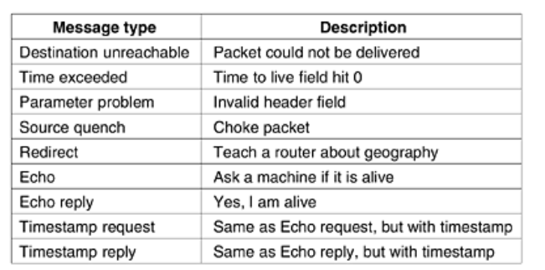
Internet Control Message Protocols

Slide 14
Internet Control Message Protocols
Echo Request and Echo Reply:
Used by: The ping command.
Purpose: To test the reachability of a network device and measure round-trip time. An Echo Request is sent to a target, and an Echo Reply is sent back if the target is reachable.
Destination Unreachable:
Types: Includes codes for various reasons, such as Network Unreachable, Host Unreachable, Protocol Unreachable, Port Unreachable, etc.
Purpose: To inform the sender that a packet could not be delivered to its destination.
Time Exceeded:
Types: Includes codes for Time-to-Live (TTL) Exceeded in Transit and Fragment Reassembly Time Exceeded.
Purpose: To indicate that a packet’s TTL value has expired or that fragmentation was not successful within the allowed time.
Redirect:
Purpose: To inform a host that a better route is available for reaching a destination. This is used by routers to update the host's routing information.
Source Quench:
Purpose: To request a sender to reduce the rate of sending data. This message is generally deprecated and not commonly used.
Parameter Problem:
Purpose: To indicate that there was a problem with the header parameters of a packet.

Slide 15
Internet Control Message Protocols
ICMP Message Format consists of :
Type: Defines the type of ICMP message (e.g., Echo Request, Destination Unreachable).
Code: Provides additional information about the type of message (e.g., specific reason for Destination Unreachable).
Checksum: Used for error-checking of the ICMP header and data.
Rest of Header/Data: Varies depending on the message type. For example, Echo Requests include an identifier and sequence number, while Destination Unreachable messages include information about the packet that could not be delivered.
Examples of ICMP Usage :
Ping Command:
Function: Sends ICMP Echo Requests to a target IP address and waits for Echo Replies. It measures the round-trip time and checks if the target is reachable.
Example: ping 8.8.8.8 (ping Google's public DNS server)
Traceroute Command:
Function: Uses ICMP (and sometimes UDP) to trace the path packets take from source to destination by sending packets with gradually increasing TTL values and reporting the intermediate hops.
Example: traceroute www.example.com

Slide 16
Internet Control Message Protocols
ICMP and Security
ICMP and Firewall Rules: ICMP can be exploited for network attacks (e.g., ping floods). Many firewalls and security devices filter ICMP traffic to mitigate these risks while allowing essential diagnostic messages.
ICMP and Network Troubleshooting: While ICMP is valuable for diagnosing network issues, its responses and capabilities can be used in network reconnaissance or denial-of-service attacks, so its use is often controlled in secure environments.
Limitations of ICMP
No Data Transfer: ICMP is designed for control messages and does not carry application data.
Potential for Misuse: ICMP can be used in various types of network attacks, such as Ping of Death or Smurf attacks.

Slide 17
The Address Resolution Protocol (ARP)
The Address Resolution Protocol (ARP) is a protocol used to map an IP address to a physical hardware address (MAC address) on a local network. It operates at the boundary between the network layer (Layer 3) and the data link layer (Layer 2) of the OSI model.
Key Functions of ARP
IP-to-MAC Mapping:
Purpose: Converts an IP address (used for routing packets) into a MAC address (used for local network communication).
Operation: When a device wants to communicate with another device on the same local network, it needs the MAC address of the destination device to properly encapsulate the data in Ethernet frames.
ARP Request:
Function: A device broadcasts an ARP Request packet to the local network, asking “Who has IP address X.X.X.X? Please send your MAC address.”
Broadcast: The ARP Request is sent to all devices on the local network segment.
ARP Reply:
Function: The device with the requested IP address responds with an ARP Reply packet, providing its MAC address.
Unicast: The ARP Reply is sent directly to the requesting device.
ARP Cache:
Purpose: To improve performance by storing recently resolved IP-to-MAC address mappings.
Function: Each device maintains an ARP cache that holds IP-to-MAC address mappings for a certain period of time. This reduces the need for frequent ARP Requests.

Slide 18
The Address Resolution Protocol (ARP)
ARP Packet Structure :
An ARP packet consists of the following fields:
Hardware Type: Indicates the type of hardware (e.g., Ethernet is 1).
Protocol Type: Specifies the protocol (e.g., IPv4 is 0x0800).
Hardware Address Length: Length of the hardware address (e.g., 6 for MAC addresses).
Protocol Address Length: Length of the protocol address (e.g., 4 for IPv4 addresses).
Operation: Specifies the type of ARP message (1 for Request, 2 for Reply).
Sender Hardware Address: MAC address of the sender.
Sender Protocol Address: IP address of the sender.
Target Hardware Address: MAC address of the intended recipient (blank in a request).
Target Protocol Address: IP address of the intended recipient.

Slide 19
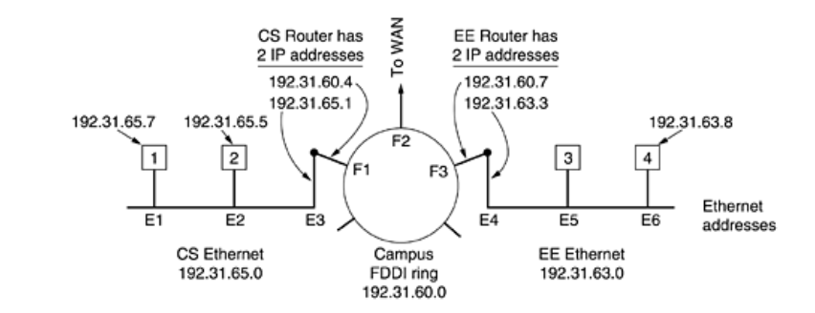
The Address Resolution Protocol (ARP)

Slide 20
The Address Resolution Protocol (ARP)
ARP Process
ARP Request:
Initiation: A device wants to communicate with a new IP address that it doesn’t have in its ARP cache.
Broadcast: It sends an ARP Request to all devices on the local network asking for the MAC address associated with that IP address.
ARP Reply:
Response: The device with the matching IP address sends an ARP Reply with its MAC address.
Unicast: The ARP Reply is sent directly to the requesting device.
Updating ARP Cache:
Cache Update: The requesting device updates its ARP cache with the new IP-to-MAC mapping.
Communication:
Data Transmission: The device can now use the MAC address to encapsulate and send data frames to the destination device.

Slide 21
The Address Resolution Protocol (ARP)
ARP Cache Management
Timeouts: ARP entries typically have a timeout period after which they are removed if not used.
Static ARP Entries: Administrators can configure static ARP entries to maintain persistent mappings, bypassing the usual ARP process.
ARP and Security
ARP Spoofing/Poisoning: An attack where a malicious device sends false ARP replies to associate its MAC address with an IP address belonging to another device. This can lead to man-in-the-middle attacks or traffic interception.
Mitigation: Techniques such as dynamic ARP inspection and static ARP entries can help mitigate ARP spoofing attacks.

Slide 22
The Address Resolution Protocol (ARP)
Example of ARP Operation
Scenario: Device A wants to communicate with Device B, but Device A only knows Device B’s IP address (192.168.1.10) and not its MAC address.
ARP Request: Device A sends an ARP Request to the local network: “Who has IP 192.168.1.10? Please send your MAC address.”
ARP Reply: Device B, with IP 192.168.1.10, replies with an ARP Reply: “I am 192.168.1.10. My MAC address is 00:1A:2B:3C:4D:5E.”
Update Cache: Device A receives the reply and updates its ARP cache with the mapping 192.168.1.10 → 00:1A:2B:3C:4D:5E.
Communication: Device A can now send data frames to Device B using the MAC address 00:1A:2B:3C:4D:5E.

